Slide 1

R Training An Introduction to R

Slide 2

Todays Agenda
Introduction to R
Basic Commands
Packages in R
Loops in R
Functions in R
Exercises

Slide 3
Introduction to R

Slide 4

Introduction to R
Introduction
Why use R?
User Interface for R
R in Financial Services
Data Structure in R

Slide 5

Definition
R is a free and open source software programming language and software environment for Statistical Computing and Graphics.
Allows user to;
Import
Analyse
Visualise
Export
Report

Slide 6

Why Use R ?

Slide 7


Benefits of using R
Free &
Open-Source
Strong Package
Ecosystem

Slide 8
Benefits of using R (Contd)
Cross-Platform Compatibility
Easy Integration with other tools

Slide 9




Benefits of using R (Contd)
Easy Integration
with other
languages
Graphics
and
Graphics
and
Visualisation

Slide 10

User Interface for R

Slide 11

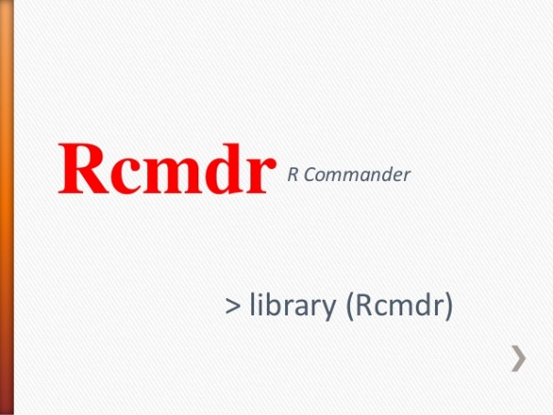


Graphical User Interface for R
R is basically a command language. Though there are different graphical user interfaces available for R like Red-R, JGR, R Commander (Rcmdr) etc., R Studio is the most popular Integrated development environment (IDE) for R.

Slide 12

Benefits of using RStudio
Rstudio allows user to run R in a more user-friendly environment. Let us look at some of it’s advantages now;
Free and open-source
Interactive visible panes are useful for exploratory data analysis
Integrates console, help pages, plots and editor (if you want it) in one place
R scripts to store and execute commands, saves time
Easily manage multiple working directories using projects
Software is available for Linux, Mac and Windows
Interactive debugger to diagnose and fix errors quickly

Slide 13
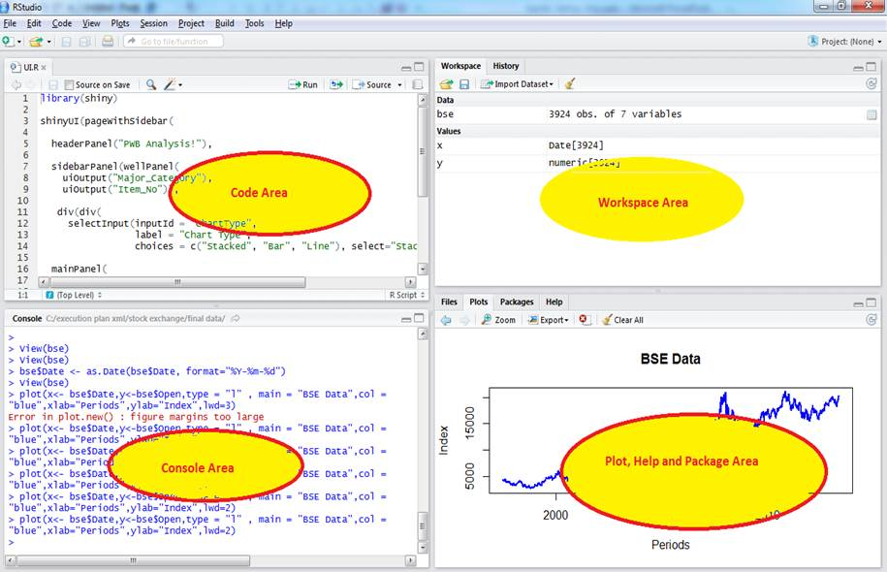
RStudio Screen

Slide 14
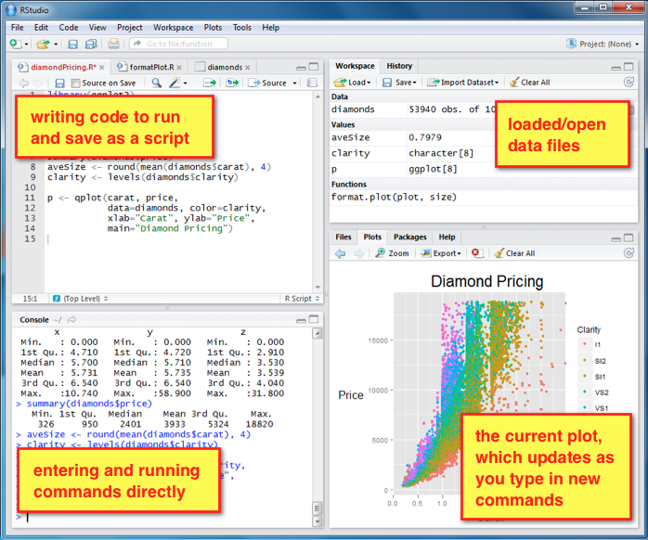
Navigating around RStudio
The usual Rstudio screen has 4 windows:
The R script(s) and data view
Workspace and history
Console
Files, plots, packages and help
1
2
4
3

Slide 15
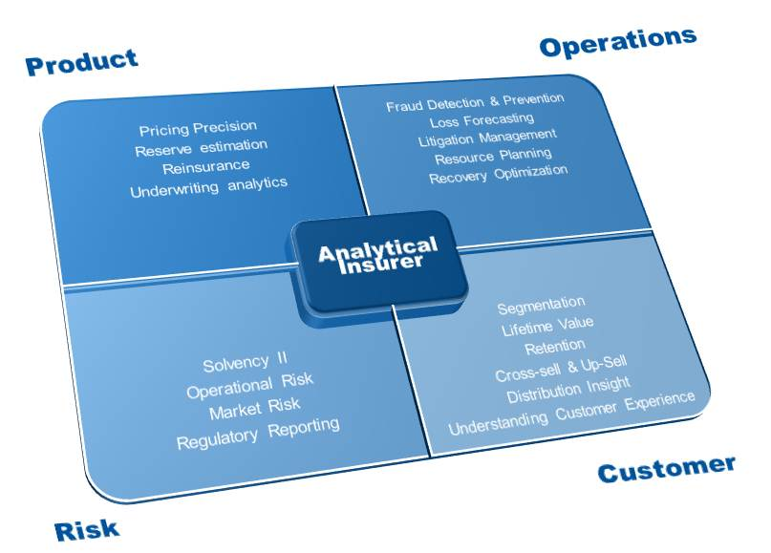
R in Financial Services

Slide 16
Analytics in Financial Services
Some of the areas where R combined with other tools and languages are used:
Predictive analytics – e.g. Real-time decision making to predict potentially fraudulent transactions
Generate bespoke analytical reports – e.g. R used with LATEX
Exposure analysis and reinsurance – e.g. R used to visualise exposure of geographic regions using Google Earth
Interactive Data Visualization – e.g. Analysis tools created using R and googleVis Package
Useful packages for Actuaries – e.g. Chain Ladder, lossDev etc

Slide 17
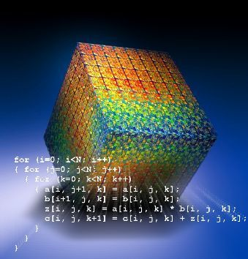
Data Structures in R

Slide 18
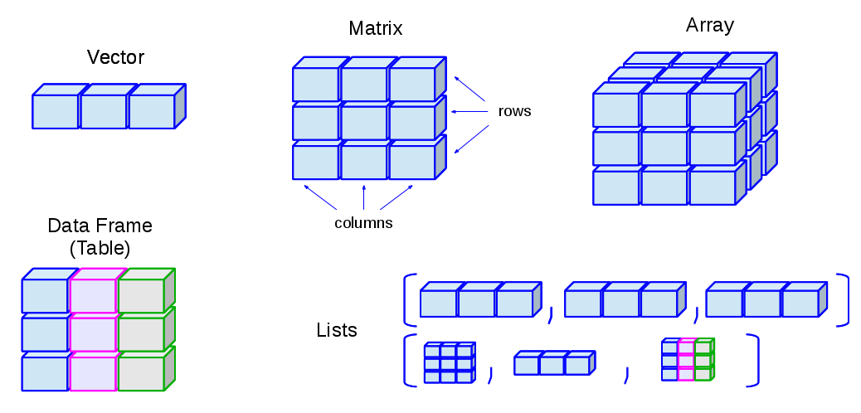
Basic data structures in R
Vector
Matrix
Array
Data Frame
List

Slide 19
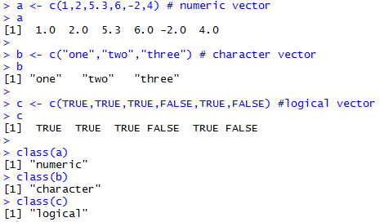
Vectors in R
Vector is a sequence of data elements of the same basic type.
Vectors can be created using the c() function.
Types - integer, numeric, logical, character, complex. Type can be confirmed using the class() function.
Here are some of the examples:

Slide 20
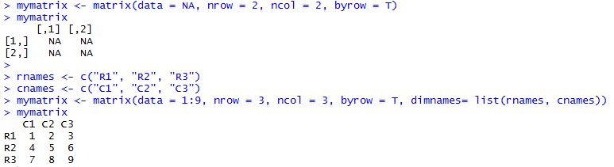
Matrix in R
Matrix is a collection of data elements arranged in a two-dimensional rectangular layout.
Matrices can be created using the matrix() function.
Syntax: matrix(vector, nrow=r, ncol=c, byrow=FALSE, dimnames=list(char_vector_rownames, char_vector_colnames))
Here are some of the examples:

Slide 21
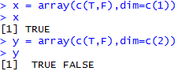
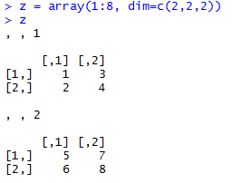
Array in R
Array is composed of n dimensions where each dimension is a vector of objects of same type.
Arrays can be created using the array() function.
Syntax: array(data = NA, dim = length(data), dimnames = NULL)
Here are some of the examples:

Slide 22
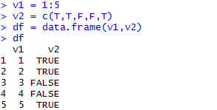
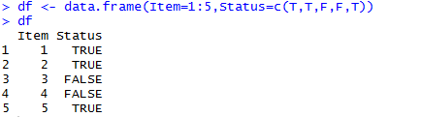
Data frame in R
Data frame is a vector of equal length, and is used for storing data tables.
Data frames can be created using the data.frame() function.
Syntax: data.frame(..., row.names = NULL, check.rows = FALSE, check.names = TRUE, fix.empty.names = TRUE,
stringsAsFactors = default.stringsAsFactors())
Here are some of the examples:

Slide 23
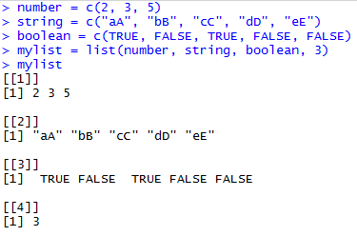
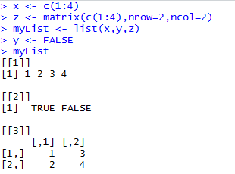
List in R
List is an ordered collection of objects, and the objects in the list do not have to be of the same type or
length.
Lists can be created using the list() function.
Here are some of the examples:

Slide 24
Basic Commands

Slide 25

Basic Commands
Basic Arithmetic
Storing variables
Using stored variables
Creating vectors and matrices

Slide 26

Basic Arithmetic
R uses the same symbols as many other mathematical software packages
To use a function, you type out its name and put the arguments within parentheses. The most basic R function is c. This combines values into a vector.
> c(2,5,8,4,2,5)
[1] 2 5 8 4 2 5
> c("Apple","Orange","Pear")
[1] "Apple" "Orange" "Pear"
Operator | Description | Example
+ | Plus | 3+3 | = 6
- | Minus | 5-2 | = 3
* | Multiply | 5*2 | = 10
/ | Divide | 10/5 | = 5
^ | Power of | 4^2 | = 16
<- OR = | Equal
%*% | Multiply Matrix/Vector

Slide 27
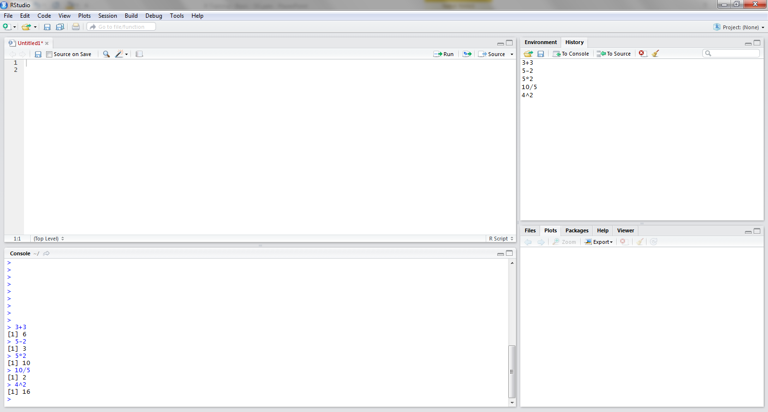
Basic Arithmetic
Past commands appear in the History section, and the command/output appear in the Console
To calculate a value, the command can be typed into the Console. Press Enter, and the output will appear below in Black. Commands appear in blue.

Slide 28

Storing variables
So commands do not have to be retyped, we can store values, or sets of values within a variable.
For example, we can assign a whole vector to a variable called D. Once the variable has been assigned a value, the variable (in this case D) will represent this value
> D = c(2,4,6,8,1,3,5,7,9)
> D
[1] 2 4 6 8 1 3 5 7 9
It is important to be aware that R is case sensitive. So if d is entered an error will occur
> d
Error: object 'd' not found
Variables can store any output, whether this be tables or calculations.
> CA = ((3+4)*8)/2
> CA
[1] 28

Slide 29

Using stored variables
Variables that hold values can be used in later commands.
Functions like Sum and Mean can be run against variables, and output can be stored in new variables.
> sum(D)
[1] 45
The mean of variable D can be stored as variable A
> A = mean(D)
> A
[1] 5
Different variables can be multiplied together
> T = D*A
> T
[1] 10 20 30 40 5 15 25 35 45

Slide 30

Using stored variables
Variable values can be dissected to extract values within the variable. For example, variable T was a vector of numbers. From variable T, we can extract certain values or sets of values from the vector
T = 10 20 30 40 5 15 25 35 45
T[2] will extract the second value in the vector
> T[2]
[1] 20
T[2:6] will extract values that are positioned 2-6 in the vector
> T[2:6]
[1] 20 30 40 5 15

Slide 31
Using stored variables
T = 10 20 30 40 5 15 25 35 45
We can apply logical statements to values, which will return True or False values
> T<25
[1] TRUE TRUE FALSE FALSE TRUE TRUE FALSE FALSE FALSE
By using ‘class’, the data type of the variable can be viewed
> class(T)
[1] "numeric"

Slide 32
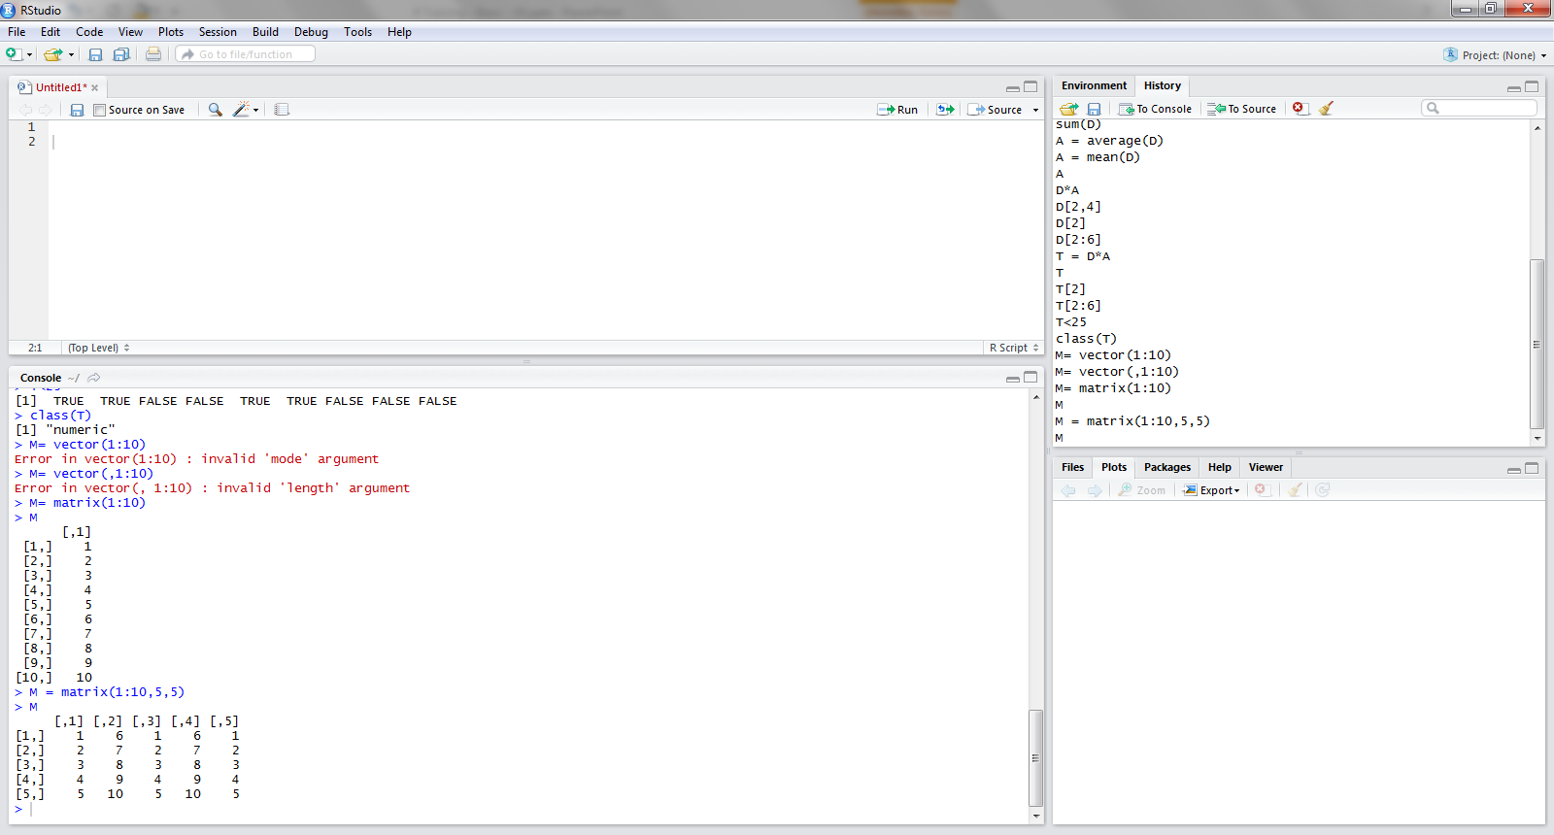
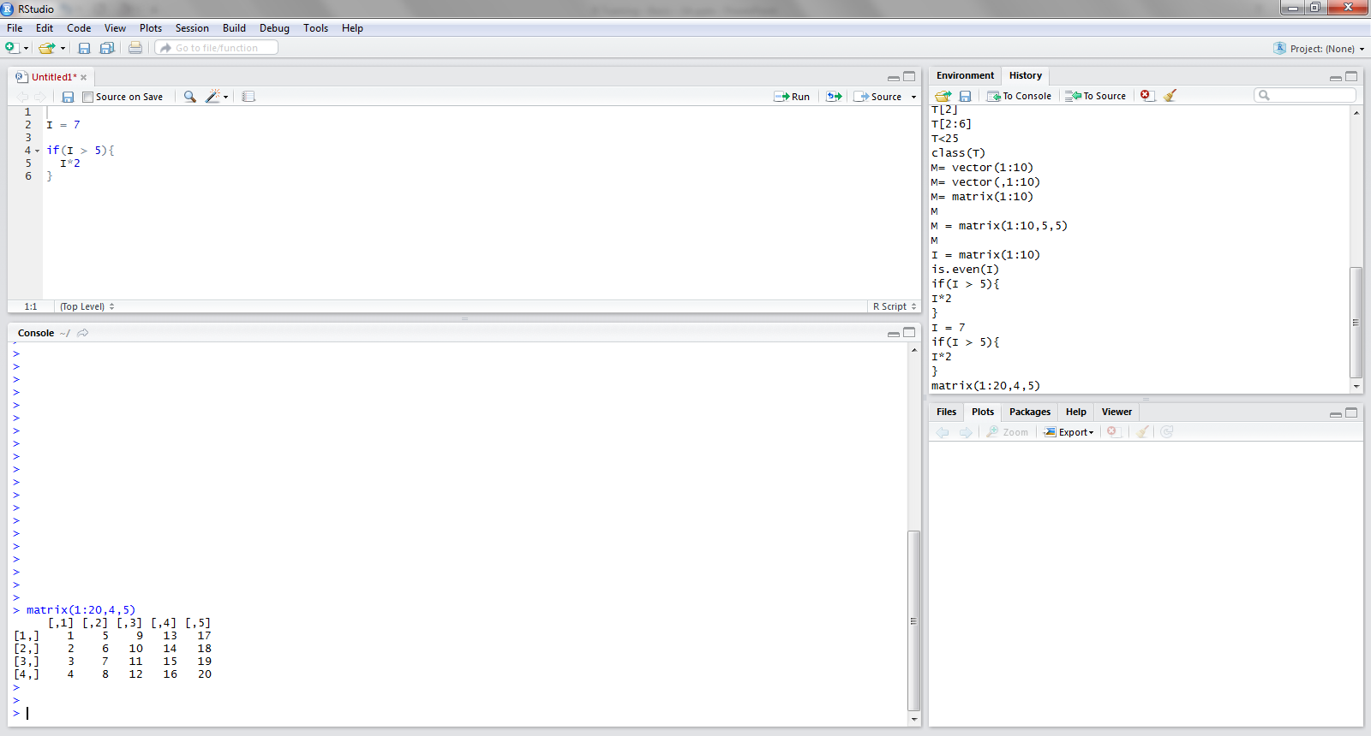
Creating vectors and matrices
Vectors or matrices can be created using the matrix function. The argument layout is:
matrix(Data range, Number of rows, Number of columns )

Slide 33
Example 1 – Basic Commands
Try typing the following commands into your Console:
x = matrix(1:5)
View(x)

Slide 34
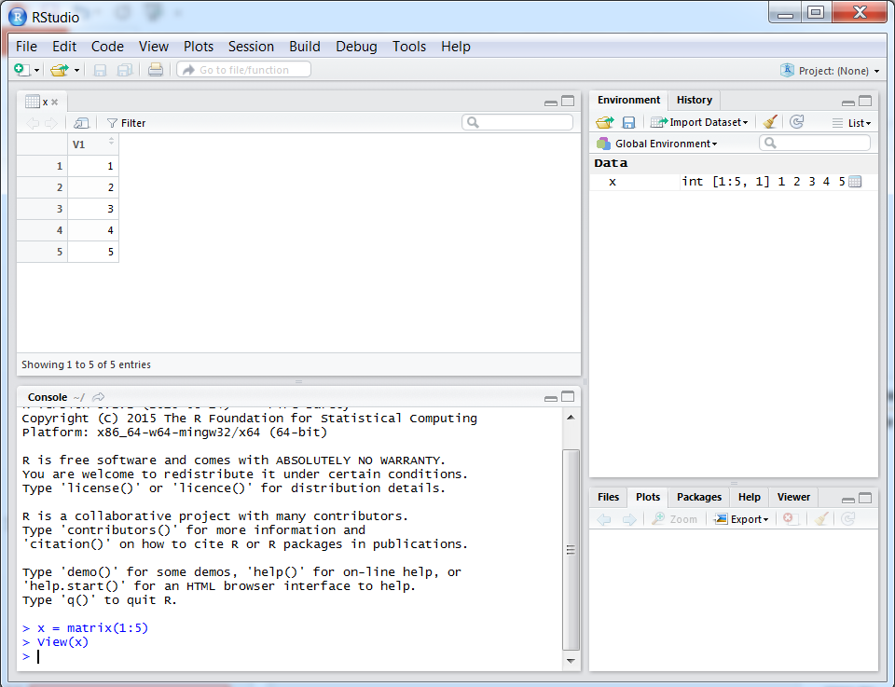
Example 1 – Basic Commands
You will see the variable x appear in your Global Environment
Try typing the following commands into your Console:
x = matrix(1:5)
View(x)
A display of the variable x in a spreadsheet-style will appear in the top-left

Slide 35
Example 1 – Basic Commands
Try typing the following commands into your Console:
x = matrix(1:5)
View(x)
x = t(x)

Slide 36
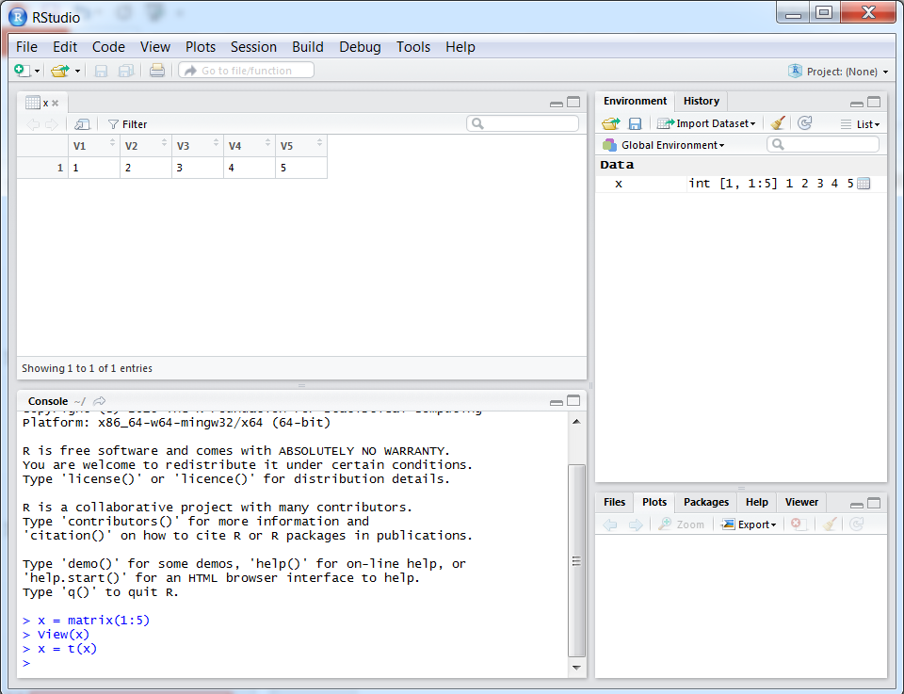
Example 1 – Basic Commands
Try typing the following commands into your Console:
x = matrix(1:5)
View(x)
x = t(x)
We have overwritten the variable x with its transpose, and the display has changed accordingly

Slide 37
Example 1 – Basic Commands
Try typing the following commands into your Console:
x = matrix(1:5)
View(x)
x = t(x)
y = rbind(x,x)
View(y)

Slide 38
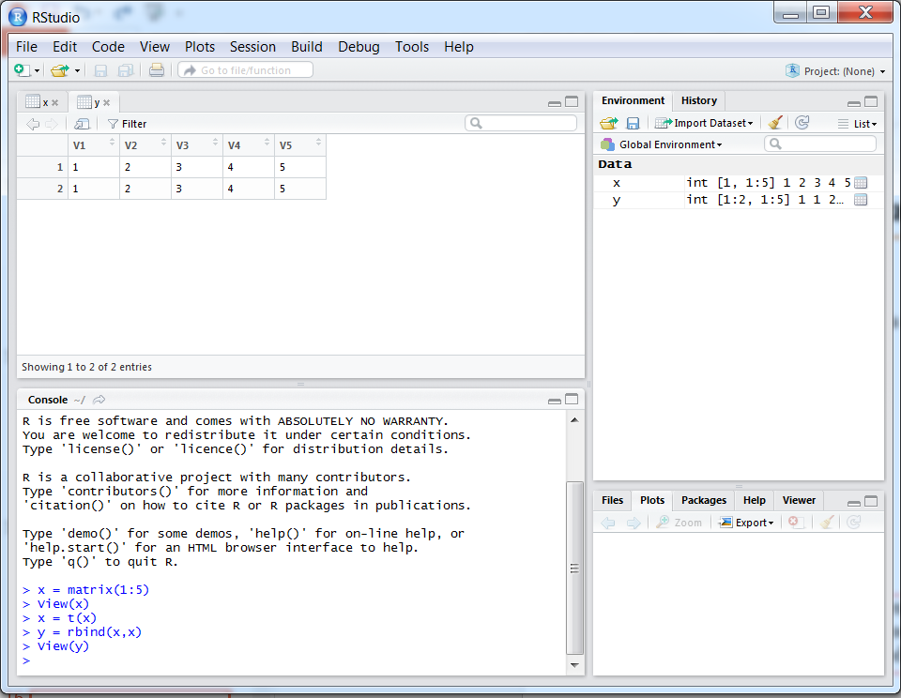
Example 1 – Basic Commands
Try typing the following commands into your Console:
x = matrix(1:5)
View(x)
x = t(x)
y = rbind(x,x)
View(y)
We have combined two copies of the variable x, one above the other, into a new variable y.

Slide 39
Example 1 – Basic Commands
Try typing the following commands into your Console:
x = matrix(1:5)
View(x)
x = t(x)
y = rbind(x,x)
View(y)
y = cbind(x,x)

Slide 40
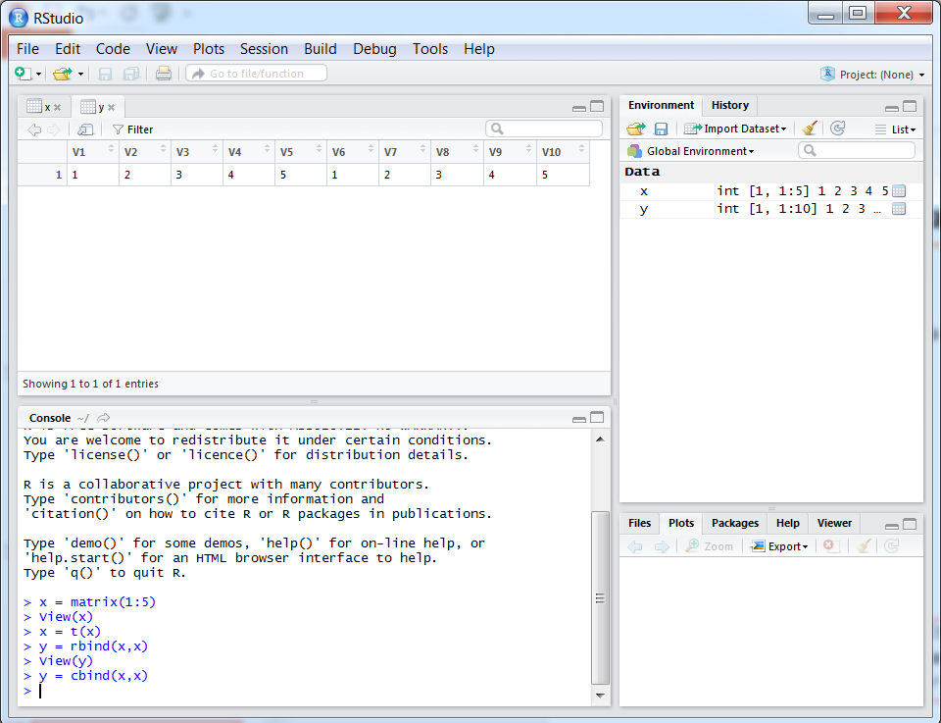
Example 1 – Basic Commands
Try typing the following commands into your Console:
x = matrix(1:5)
View(x)
x = t(x)
y = rbind(x,x)
View(y)
y = cbind(x,x)
So we can combine two copies of x side by side as well

Slide 41
Packages in R

Slide 42
Packages in R
Introduction to packages
Using standard packages
Loading and using contributed packages

Slide 43
Introduction to packages

Slide 44
Introduction to packages
R is open source, so members of the public write their own functions for R, and publish them in packages along with supporting documentation. So the capabilities of R are extended through user-created packages, and these are free libraries of code, written by the active R community.
Standard packages: these come automatically installed with R and include useful basic functions.
E.g. the package base contains functions such as sum, mean, and log, whilst the package graphics includes functions such as plot, pie, and hist.
Contributed packages: thousands written by many authors. Some implement specialised statistical methods, some give access to data, and others complement textbooks.
E.g. the contributed package quantmod includes functions to assist analysts working at banks with their trading models.
Packages are maintained by the R Core Team and by the R community.
To see which packages are installed in your library, issue the following command in your Console:
library()

Slide 45
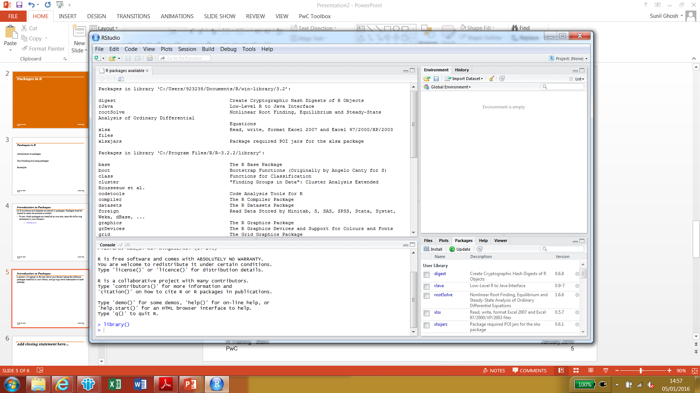
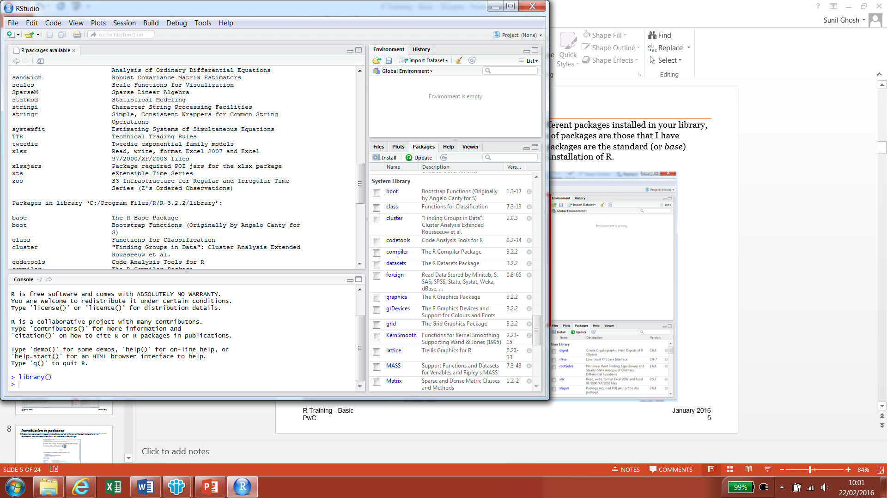
Introduction to packages
Typing library() into your console will bring up a screen in the top left listing the different packages installed in your R library, and giving a description of each package. The first section of packages are those that I have manually installed into my own R library. The second section of packages are the standard packages that have been automatically downloaded during the installation of R.

Slide 46
Introduction to packages
Alternatively, you can click on the Packages tab in the bottom right of your Studio to see a list of the packages installed in your library as well.

Slide 47
Introduction to packages
Alternatively, you can click on the Packages tab in the bottom right of your Studio to see a list of the packages installed in your library as well.
You can find out more about each package by clicking its name in the Packages tab.

Slide 48
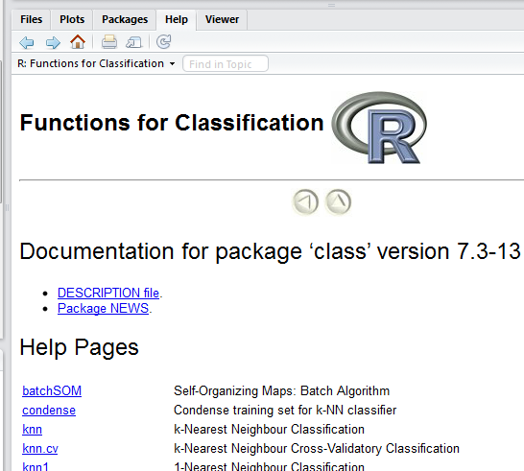
Introduction to packages
E.g. clicking on the name of the package class in the Packages tab will open up the Help tab and bring up information and documentation about the contents of the package.
Alternatively, you can type a command like the following into the Console to find out more about a package:
library(help = “class”)
As R is widely used, you can easily find out more about different packages from the Internet.

Slide 49
Using standard packages

Slide 50
Using standard packages
The standard packages that come installed in R provide many useful functions. These have different arguments/inputs, some of which are optional, and you can learn about the different ways to apply these functions through the Help tab or via the Internet. The following slides list a number of commonly used functions from the base packages, and this gives an idea of the available tools in R.
Function | Package | Description
sum | base | Returns sum of values
mean | base | Returns (arithmetic) mean/average
class | base | Returns the class attribute of an object
max and min | base | Calculates the maximum/minimum
c | base | Combines values into a vector/list
t | base | Gives the transpose of a matrix or data frame
log | base | Calculates logarithms to different bases
function | base | Used to define new functions in R
matrix | base | Creates a matrix from a set of values
scan | base | Reads data into a vector
rbind and cbind | base | Joins vectors together
plot | graphics | Creates simple scatter graphs

Slide 51
Using standard packages
Function | Package | Description
approx | stats | Returns list of points that linearly interpolate given data points
chisq.test | stats | Pearson’s Chi-squared test for count data
Poisson | stats | Probabilistic functions associated with the Poisson distribution
uniroot | stats | One dimensional root finding
aggregate | stats | Splits data into subsets and commutes summary statistics
cor, cov, var | stats | Computes variance, covariance and correlation of vectors
install.packages | utils | Download/install packages from internet or local files
savehistory | utils | Save the command history
write.table | utils | Prints objects from R to a file
write.csv | utils | Prints objects from R to a csv file
read.table | utils | Reads a file, in a table format, and creates a data frame in R
read.csv | utils | Reads a csv file and creates a data frame in R
View | utils | Spreadsheet-style data viewer within R

Slide 52
Loading and using contributed packages

Slide 53
Loading and using contributed packages
The power of R is realised when you start to find out about and use the user-contributed packages, available for free, as R is open source.
There are packages available that contain functions that perform tasks in a range of fields, such as database manipulation, machine learning, finance, and network analysis, to name a few.
We will demonstrate how to install and use contributed packages with an example in network analysis.
Note that you will need to be connected to the Internet to download R packages.

Slide 54
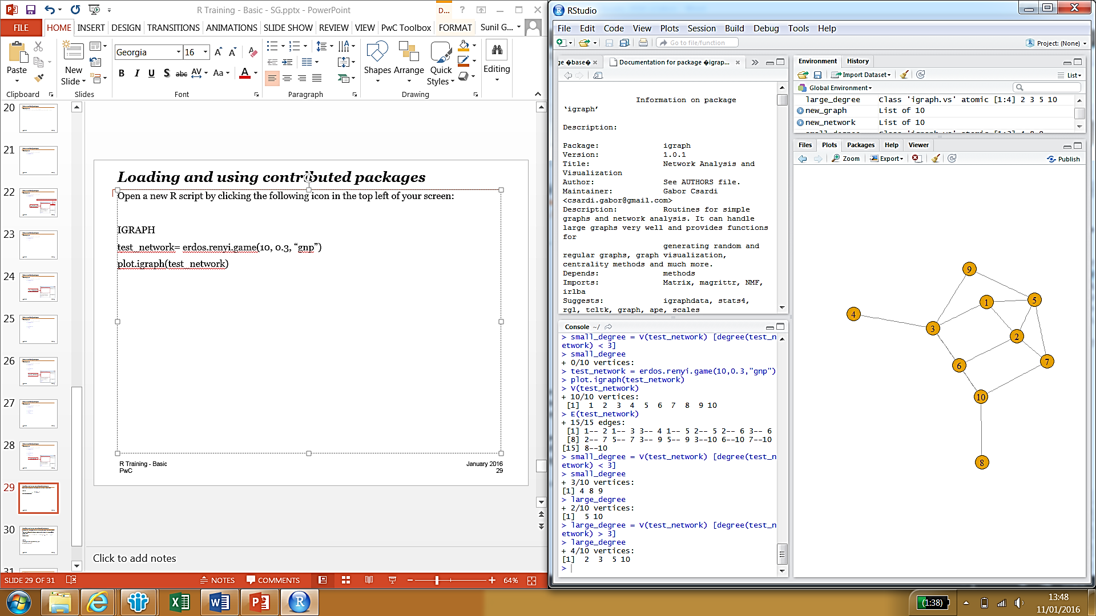
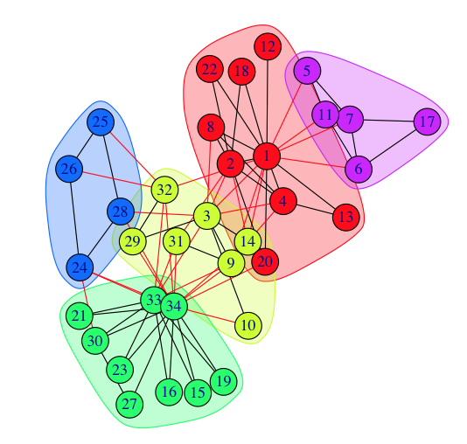
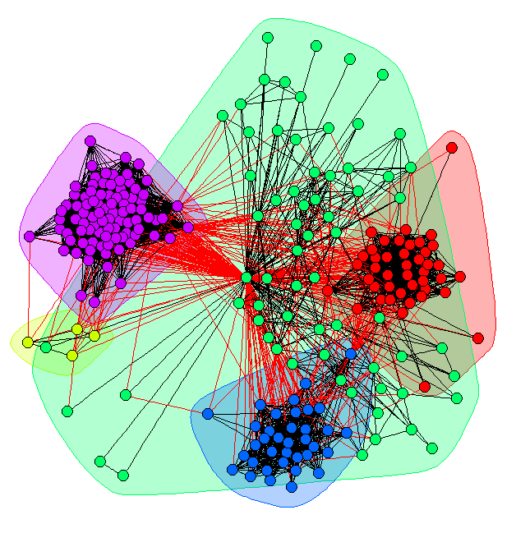
Loading and using contributed packages
Run the below command in your Console. It will download the package igraph from the Internet and store it locally on your Computer:
install.packages(“igraph”)
Open a new R script by clicking the following icon in the top left of your screen:
We are going to build a small script to introduce and explore the igraph package.

Slide 55
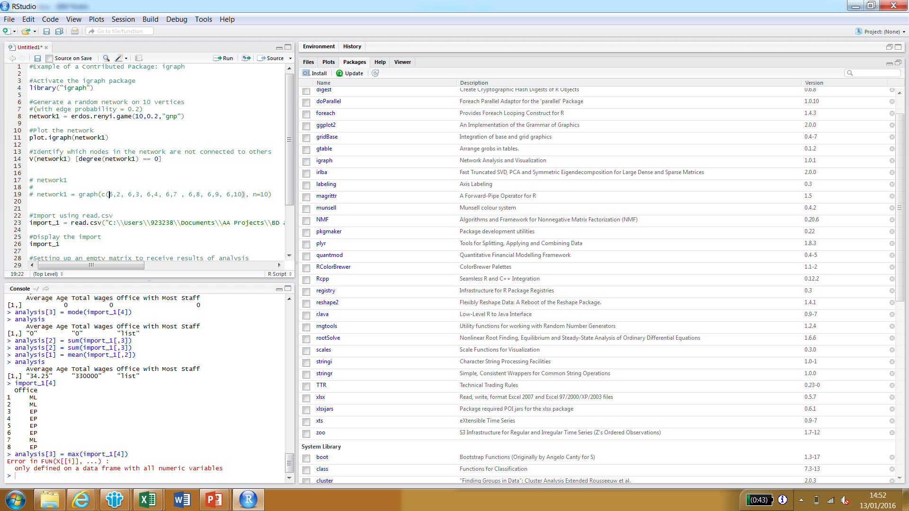
Loading and using contributed packages
To activate the igraph package in your version of R, type the following into your script, and run the script by pressing Control+A followed by Control+Enter:

Slide 56
Loading and using contributed packages
Add the following to your script (lines 6-11). Then execute the whole script (Control+A followed by Control+Enter).

Slide 57
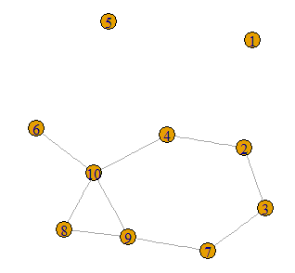
Loading and using contributed packages
You will see a plot come up in the Plots tab, showing a network with 10 nodes (or vertices) and with a number of connections (or edges) between them, similar to the example at the bottom.

Slide 58
Loading and using contributed packages
So we can use R together with the igraph package to model any kind of network, with applications in areas such as social media.

Slide 59
Loading and using contributed packages
The igraph package comes with a number of tools and functions to analyse such networks.

Slide 60
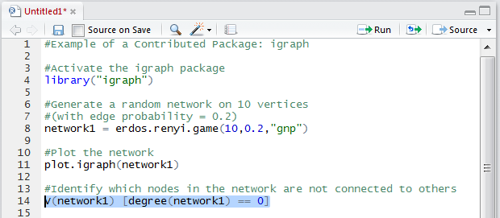
Loading and using contributed packages
For example, type the next command (lines 13-14) into your script, and execute just that line by highlighting it and pressing Control+Enter:

Slide 61
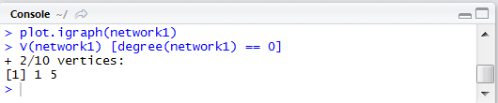
Loading and using contributed packages
For example, type the next command (lines 13-14) into your script, and execute just that line by highlighting it and pressing Control+Enter:
In my Console, the following appears:

Slide 62
Loading and using contributed packages
For example, type the next command (lines 13-14) into your script, and execute just that line by highlighting it and pressing Control+Enter:
In my Console, the following appears:
So we have identified the isolated nodes in the network

Slide 63
Loading and using contributed packages
For example, type the next command (lines 13-14) into your script, and execute just that line by highlighting it and pressing Control+Enter:
As the igraph package is widely used, there are a number of online tutorials where you can find out more on how to make use of its contents, and there is also the Help tab built into R.
There are also some further examples of simple network analysis in the demonstrator’s script.
In my Console, the following appears:
So we have identified the isolated nodes in the network

Slide 64
Importing/exporting data

Slide 65

Importing/exporting data
Importing methods
Using the wizard
Using pre-defined functions in a script
Exporting methods
Copy and paste from the table viewer
Using pre-defined functions in a script

Slide 66
Importing methods: using the Wizard

Slide 67
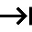
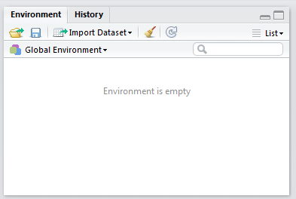
Importing methods: using the Wizard
R Studio comes with a wizard that allows you to import delimited text files.
The wizard allows you to import data into R from a number of different formats of delimited text file including:
Comma delimited
Semicolon delimited
Tab delimited
The wizard can be located in the Environment tab in the top right of R Studio:

Slide 68
Importing methods: using functions in scripts

Slide 69






Importing methods: using functions in scripts
There are functions and packages that let you import data into R, from different formats and file types, giving flexibility and allowing you to work between R and lots of other software tools. Some examples are listed in the table below.
Function | Package | Description
scan | base | Reads data into a vector
read.table | utils | Reads a file, in a table format, and creates a data frame in R
read.csv | utils | Reads a csv file and creates a data frame in R
read.fwf | utils | Reads a fixed width file
read.xlsx | xlsx | Reads an Excel worksheet and creates a data frame in R
readClipboard | utils | Reads a table from the Clipboard
read_gs | googlesheets | Reads in a Google Spreadsheet
read_spss | foreign | Reads in a SPSS file
read_dta | foreign | Reads in a STATA file
read.xport | SASxport | Reads in a SAS xport file

Slide 70
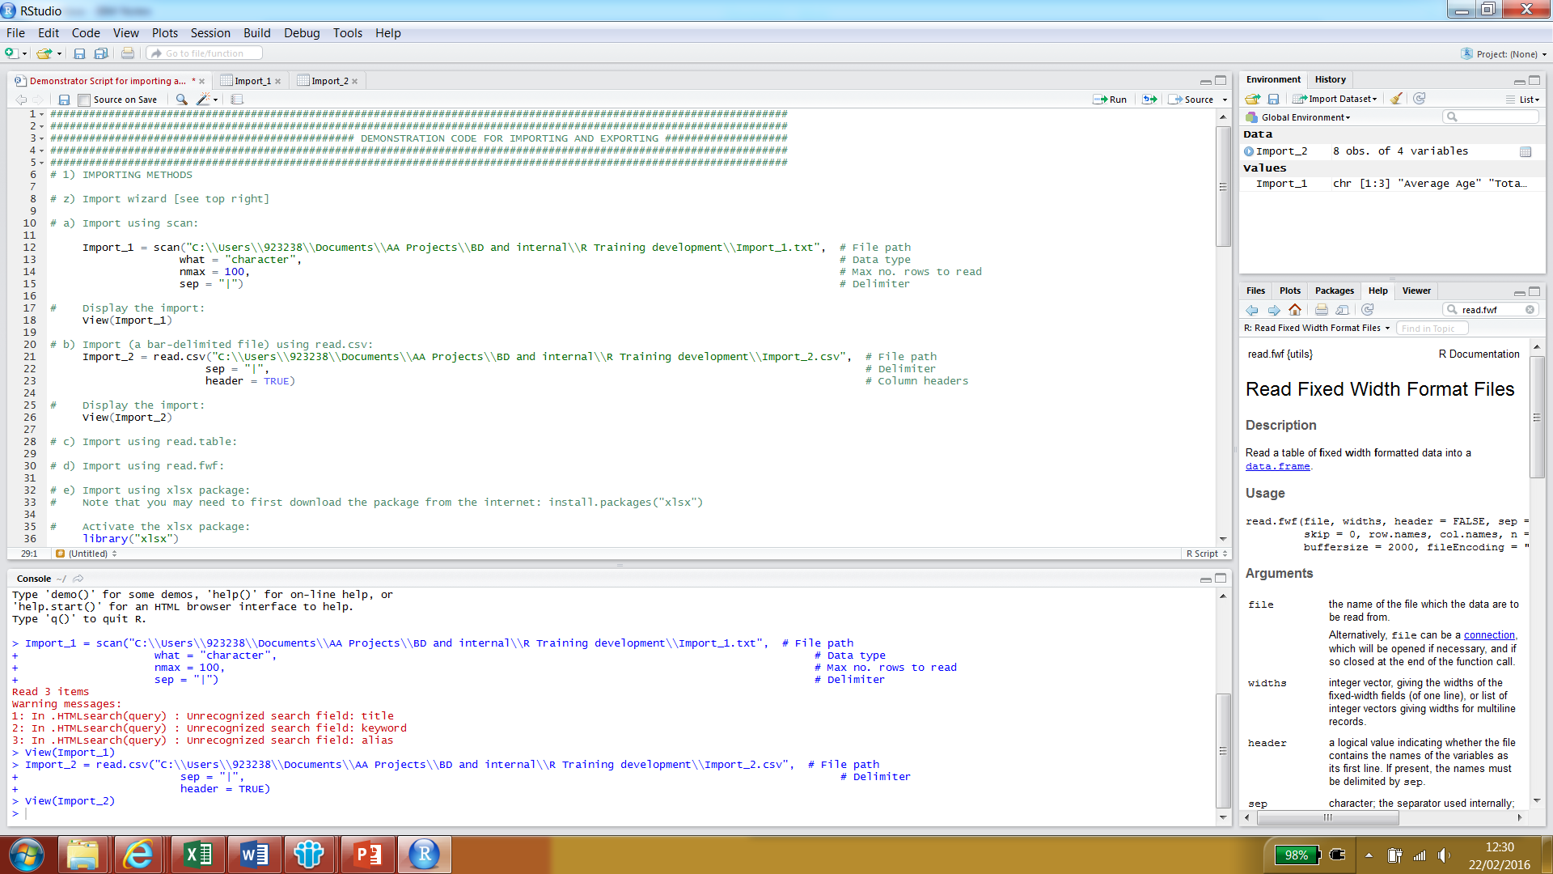
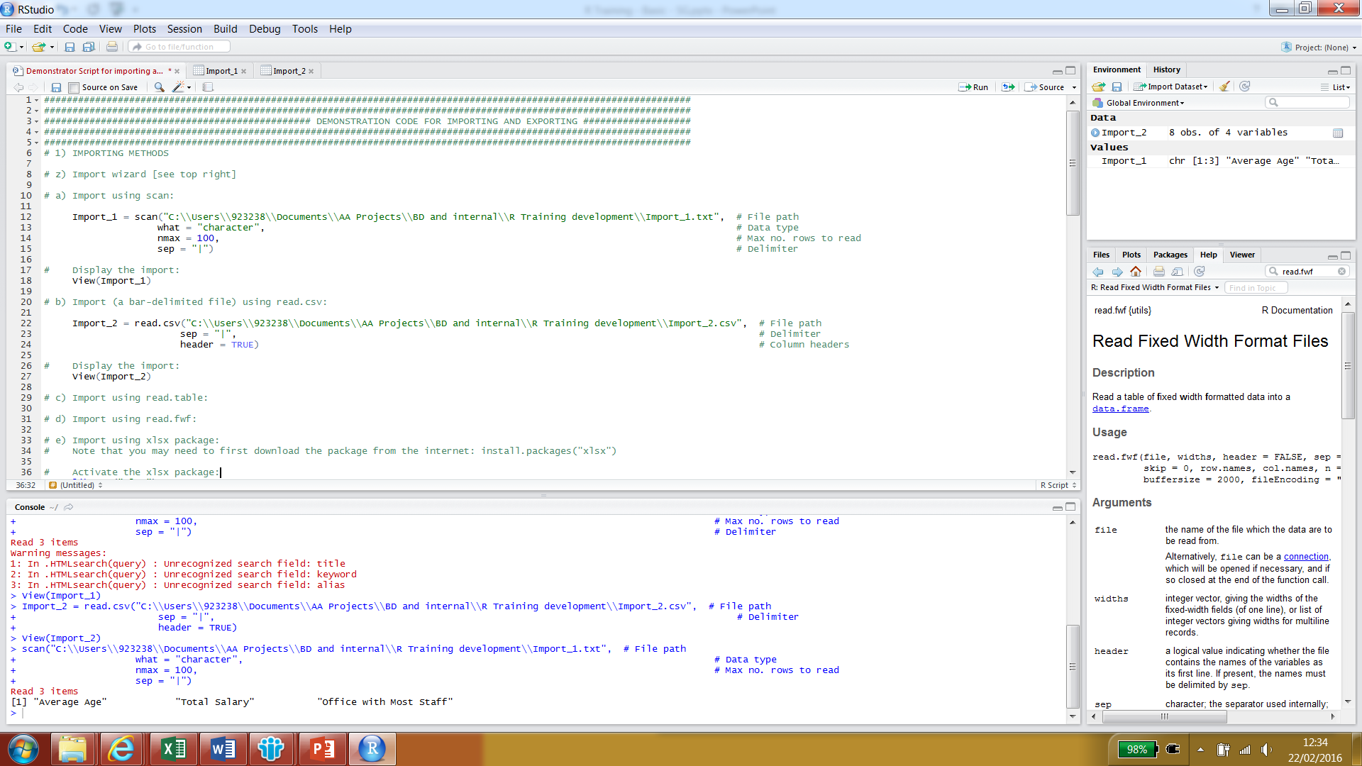
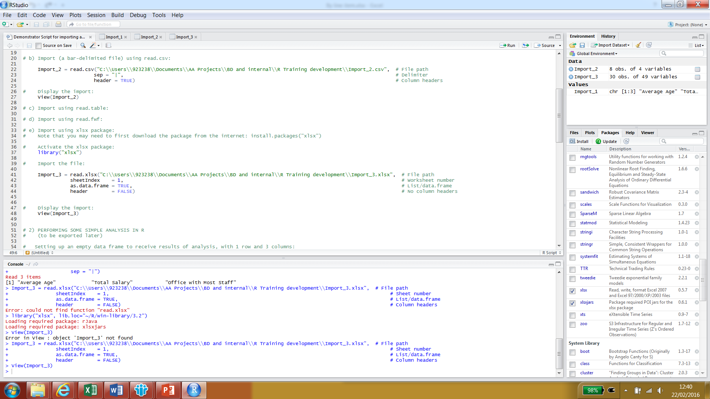
Importing methods: using functions in scripts
For each of the different functions used to import data into R, there is a particular syntax, which you can find out more about through the Help tab or via the Internet. An example of how to use scan, read.csv and read.xlsx is displayed below.
Using scan :
Using read.csv :
Using read.xlsx :

Slide 71
Exporting methods: from the table viewer

Slide 72
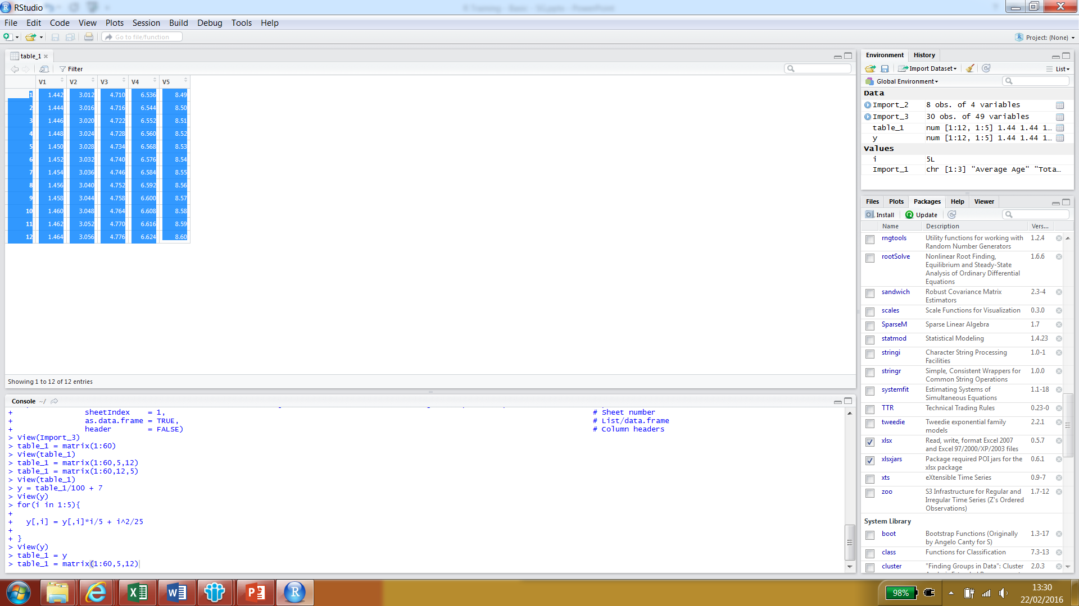
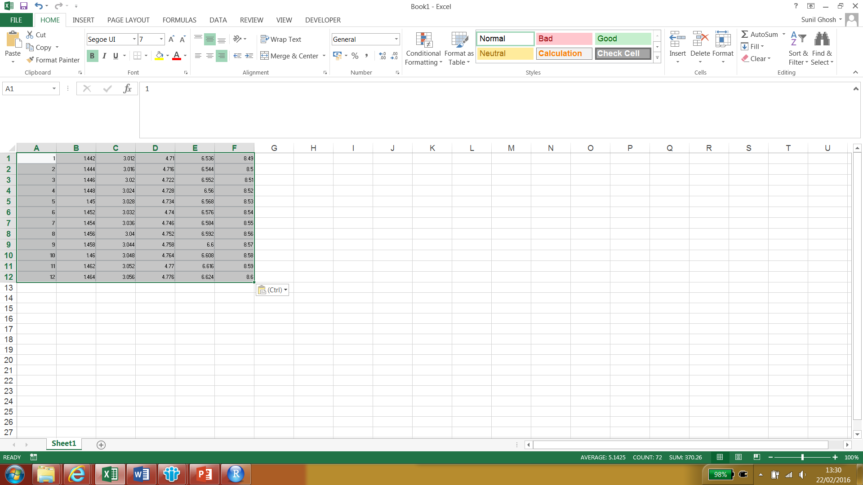
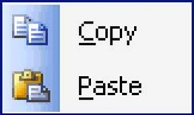
Exporting methods: from the table viewer
If we have a table of data stored as a matrix/data frame in R, we can use the View function in R to bring it up in a spreadsheet display. We can highlight the display and then copy and paste these spreadsheet views directly into Microsoft Excel as needed.

Slide 73

Exporting methods: using functions in scripts

Slide 74



Exporting methods: using functions in scripts
Like importing data, there are functions and packages that let you export data from R, into different formats and file types, giving flexibility and allowing you to work between R and lots of other software tools. Some examples are listed in the table below.
Function | Package | Description
write.table | utils | Writes a file, in a table format, from a data frame in R
write.csv | utils | Writes a csv file
write.xlsx | xlsx | Writes an Excel worksheet from data frame in R
writeClipboard | utils | Writes a vector to the Clipboard
write.foreign | foreign | Writes to different file formats, e.g. STATA, SAS, SPSS

Slide 75
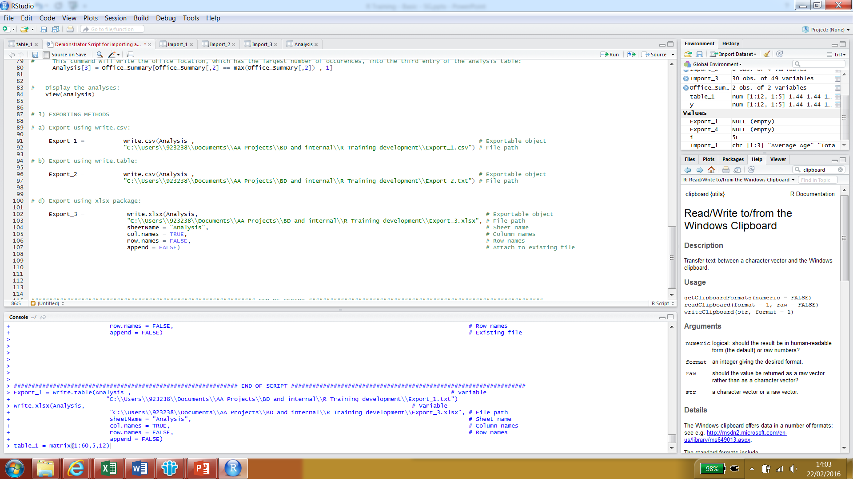
Exporting methods: using functions in scripts
For each of the different functions used to export data from R, there is a particular syntax, which you can find out more about through the Help tab or via the Internet. An example of how to use write.csv, write.table and write.xlsx is displayed below.
Using write.csv :
Using write.table :
Using write.xlsx :

Slide 76
Loops in R

Slide 77

Loops in R
An Introduction to Loops
The Benefits of Using Loops
The Disadvantages of Using Loops
Types of Loops
Examples

Slide 78
An Introduction to Loops
‘Looping’, ‘cycling’, ‘iterating’ or just replicating instructions is quite an old practice that originated well before the invention of computers. It is nothing more than automating a certain multi step process by organizing sequences of actions (‘batch’ processes) and grouping the parts in need of repetition.

Slide 79
An Introduction to Loops
‘Looping’, ‘cycling’, ‘iterating’ or just replicating instructions is quite an old practice that originated well before the invention of computers. It is nothing more than automating a certain multi step process by organizing sequences of actions (‘batch’ processes) and grouping the parts in need of repetition.
More specifically, in R, every time an operation has to be repeated, a loop may come in handy. Rather than repeating the syntax of an operation a certain number of times, we only need to specify how many times or upon which conditions those operations need execution:

Slide 80
An Introduction to Loops
‘Looping’, ‘cycling’, ‘iterating’ or just replicating instructions is quite an old practice that originated well before the invention of computers. It is nothing more than automating a certain multi step process by organizing sequences of actions (‘batch’ processes) and grouping the parts in need of repetition.
More specifically, in R, every time an operation has to be repeated, a loop may come in handy. Rather than repeating the syntax of an operation a certain number of times, we only need to specify how many times or upon which conditions those operations need execution:
Assign initial values to a control loop variable.

Slide 81
An Introduction to Loops
‘Looping’, ‘cycling’, ‘iterating’ or just replicating instructions is quite an old practice that originated well before the invention of computers. It is nothing more than automating a certain multi step process by organizing sequences of actions (‘batch’ processes) and grouping the parts in need of repetition.
More specifically, in R, every time an operation has to be repeated, a loop may come in handy. Rather than repeating the syntax of an operation a certain number of times, we only need to specify how many times or upon which conditions those operations need execution:
Assign initial values to a control loop variable.
Perform the loop.

Slide 82
An Introduction to Loops
‘Looping’, ‘cycling’, ‘iterating’ or just replicating instructions is quite an old practice that originated well before the invention of computers. It is nothing more than automating a certain multi step process by organizing sequences of actions (‘batch’ processes) and grouping the parts in need of repetition.
More specifically, in R, every time an operation has to be repeated, a loop may come in handy. Rather than repeating the syntax of an operation a certain number of times, we only need to specify how many times or upon which conditions those operations need execution:
Assign initial values to a control loop variable.
Perform the loop.
Do something with the results.

Slide 83
The Benefits of Using Loops
As we mentioned earlier, loops allow us to group and automate operations which facilitates a significant reduction in the amount of code needed to carry out the exactly same process.

Slide 84
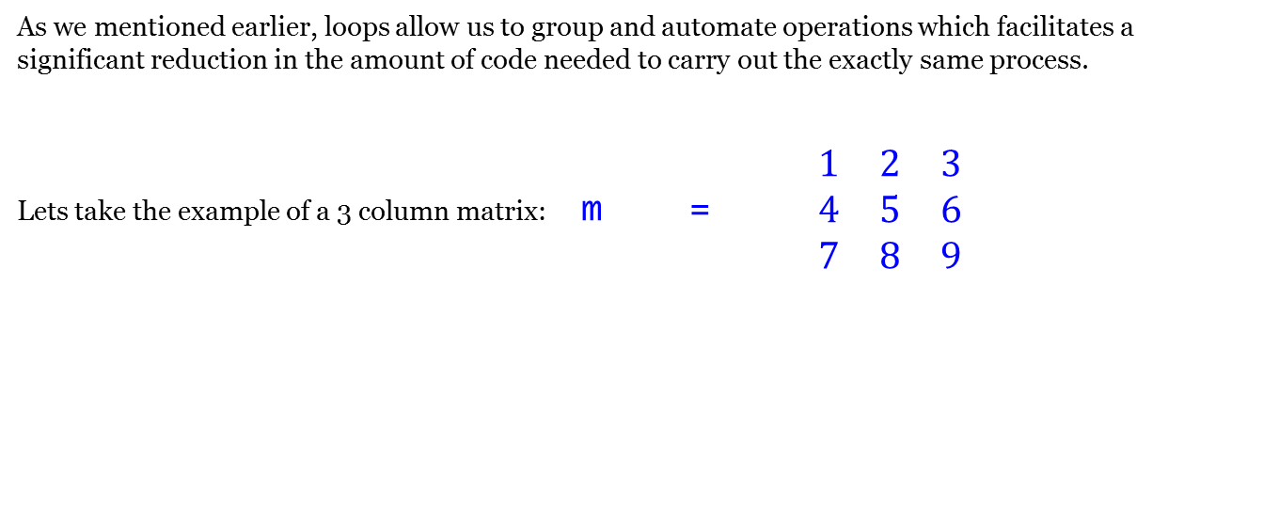
The Benefits of Using Loops
As we mentioned earlier, loops allow us to group and automate operations which facilitates a significant reduction in the amount of code needed to carry out the exactly same process.
Lets take the example of a 3 column matrix: m = $\begin{matrix}1 & 2 & 3 \\ 4 & 5 & 6 \\ 7 & 8 & 9\end{matrix}$

Slide 85
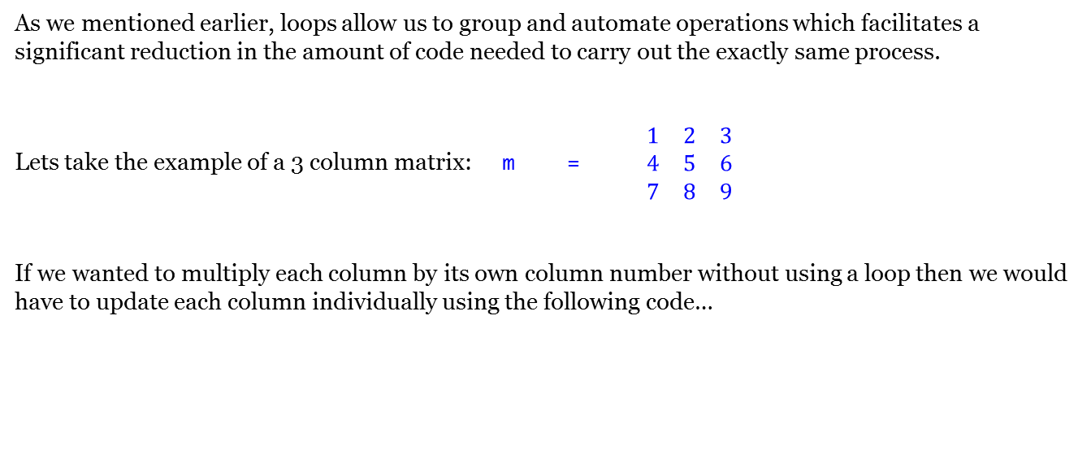
The Benefits of Using Loops
As we mentioned earlier, loops allow us to group and automate operations which facilitates a significant reduction in the amount of code needed to carry out the exactly same process.
Lets take the example of a 3 column matrix: m = $\begin{matrix}1 & 2 & 3 \\ 4 & 5 & 6 \\ 7 & 8 & 9\end{matrix}$
If we wanted to multiply each column by its own column number without using a loop then we would have to update each column individually using the following code…

Slide 86
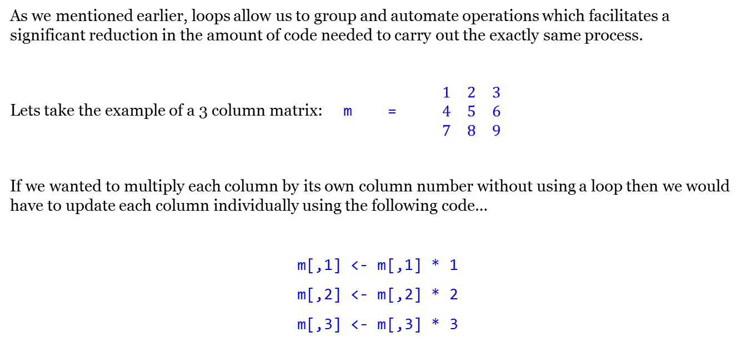
The Benefits of Using Loops
As we mentioned earlier, loops allow us to group and automate operations which facilitates a significant reduction in the amount of code needed to carry out the exactly same process.
Lets take the example of a 3 column matrix: m = $\begin{matrix}1 & 2 & 3 \\ 4 & 5 & 6 \\ 7 & 8 & 9\end{matrix}$
If we wanted to multiply each column by its own column number without using a loop then we would have to update each column individually using the following code…
m[,1] <- m[,1] * 1
m[,2] <- m[,2] * 2
m[,3] <- m[,3] * 3

Slide 87
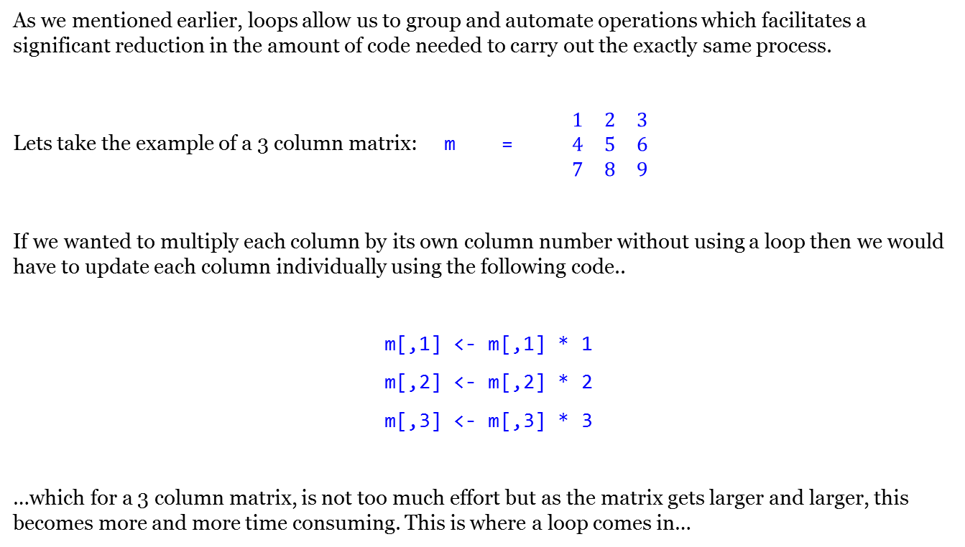
The Benefits of Using Loops
As we mentioned earlier, loops allow us to group and automate operations which facilitates a significant reduction in the amount of code needed to carry out the exactly same process.
Lets take the example of a 3 column matrix: m = $\begin{matrix}1 & 2 & 3 \\ 4 & 5 & 6 \\ 7 & 8 & 9\end{matrix}$
If we wanted to multiply each column by its own column number without using a loop then we would have to update each column individually using the following code..
m[,1] <- m[,1] * 1
m[,2] <- m[,2] * 2
m[,3] <- m[,3] * 3
…which for a 3 column matrix, is not too much effort but as the matrix gets larger and larger, this becomes more and more time consuming. This is where a loop comes in…

Slide 88
The Benefits of Using Loops
This operation can be simplified and coded in a more efficient way using a loop as follows:

Slide 89
The Benefits of Using Loops
This operation can be simplified and coded in a more efficient way using a loop as follows:
for (i in 1:3)
{
m[,i] <- m[,i] * i
}

Slide 90
The Benefits of Using Loops
This operation can be simplified and coded in a more efficient way using a loop as follows:
for (i in 1:3)
{
m[,i] <- m[,i] * i
}
1. Assign variables to control the loop

Slide 91
The Benefits of Using Loops
This operation can be simplified and coded in a more efficient way using a loop as follows:
for (i in 1:3)
{
m[,i] <- m[,i] * i
}
1. Assign variables to control the loop
2. Begin loop

Slide 92
The Benefits of Using Loops
This operation can be simplified and coded in a more efficient way using a loop as follows:
for (i in 1:3)
{
m[,i] <- m[,i] * i
}
1. Assign variables to control the loop
2. Begin loop
3. Operation using the variables set in step 1.

Slide 93
The Benefits of Using Loops
This operation can be simplified and coded in a more efficient way using a loop as follows:
for (i in 1:3)
{
m[,i] <- m[,i] * i
}
1. Assign variables to control the loop
2. Begin loop
3. Operation using the variables set in step 1
4. End loop

Slide 94
The Benefits of Using Loops
This operation can be simplified and coded in a more efficient way using a loop as follows:
for (i in 1:3)
{
m[,i] <- m[,i] * i
}
1. Assign variables to control the loop
2. Begin loop
3. Operation using the variables set in step 1.
4. End loop
The coding of this operation remains the same regardless of the number of times that it needs to be performed. The only thing that changes is range of the variable on the first line of the code. This becomes very useful when analysing large data sets because rather than write the same operation n times, we only need to use one operation.

Slide 95
The Benefits of Using Loops
This operation can be simplified and coded in a more efficient way using a loop as follows:
for (i in 1:3)
{
m[,i] <- m[,i] * i
}
1. Assign variables to control the loop
2. Begin loop
3. Operation using the variables set in step 1.
4. End loop
The coding of this operation remains the same regardless of the number of times that it needs to be performed. The only thing that changes is range of the variable on the first line of the code. This becomes very useful when analysing large data sets because rather than write the same operation n times, we only need to use one operation.
You can perform as many separate operations within a loop as you like which allows you to carry out complex analysis on a case by case basis and can be very powerful.
Notes:
Explain how this was helpful in EIOPA Rfr – looping through countries and currencies

Slide 96
The Benefits of Using Loops
This operation can be simplified and coded in a more efficient way using a loop as follows:
for (i in 1:3)
{
m[,i] <- m[,i] * i
}
1. Assign variables to control the loop
2. Begin loop
3. Operation using the variables set in step 1.
4. End loop
The coding of this operation remains the same regardless of the number of times that it needs to be performed. The only thing that changes is range of the variable on the first line of the code. This becomes very useful when analysing large data sets because rather than write the same operation n times, we only need to use one operation.
You can perform as many separate operations within a loop as you like which allows you to carry out complex analysis on a case by case basis and can be very powerful.
The above shows a “for” loop which is very specific about the range of variables that control the loop, another type of loop known as a “while loop” provides additional flexibility for a repeating process by allowing the automation of an operation be performed based on a condition.

Slide 97

The Disadvantages of Using Loops
As we have already mentioned, loops are very intuitive and useful but if they are used incorrectly or in certain situations, they have one main drawback:

Slide 98

The Disadvantages of Using Loops
As we have already mentioned, loops are very intuitive and useful but if they are used incorrectly or in certain situations, they have one main drawback:
Loops can be slow

Slide 99
The Disadvantages of Using Loops
As we have already mentioned, loops are very intuitive and useful but if they are used incorrectly or in certain situations, they have one main drawback:
Loops can be slow
It is not always necessary to use loops, their significantly larger processing time compared to other commands means that they should only be used when absolutely necessary.

Slide 100
The Disadvantages of Using Loops
As we have already mentioned, loops are very intuitive and useful but if they are used incorrectly or in certain situations, they have one main drawback:
Loops can be slow
It is not always necessary to use loops, their significantly larger processing time compared to other commands means that they should only be used when absolutely necessary.
“Growing” the data set by using cbind or rbind inside a loop is a bad idea if you are looking for good processing speeds and efficient programming.

Slide 101
The Disadvantages of Using Loops
As we have already mentioned, loops are very intuitive and useful but if they are used incorrectly or in certain situations, they have one main drawback:
Loops can be slow
It is not always necessary to use loops, their significantly larger processing time compared to other commands means that they should only be used when absolutely necessary.
“Growing” the data set by using cbind or rbind inside a loop is a bad idea if you are looking for good processing speeds and efficient programming.
It is better to create a blank output first and then fill it in using a loop.

Slide 102

Types of Loops
There are two main types of loops which we will now look into in more detail:

Slide 103
Types of Loops
There are two main types of loops which we will now look into in more detail:
For Loops – used to iterate over a vector with distinct values.

Slide 104
Types of Loops
There are two main types of loops which we will now look into in more detail:
For Loops – used to iterate over a vector with distinct values.
While Loops – used to loop until a specified condition is met.

Slide 105

For Loops
How does a For Loop work?

Slide 106
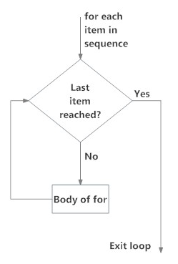
For Loops
How does a For Loop work?

Slide 107
For Loops
How does a For Loop work?
Before initiating the loop, the sequence on which the loop is executed must be defined.

Slide 108
For Loops
How does a For Loop work?
Before initiating the loop, the sequence on which the loop is executed must be defined.
The statement is executed using each value of the sequence as an input on a case by case basis.

Slide 109
For Loops
How does a For Loop work?
Before initiating the loop, the sequence on which the loop is executed must be defined.
The statement is executed using each value of the sequence as an input on a case by case basis.
When the last item of the sequence is reached, the loop operator terminates.

Slide 110
For Loops – Syntax
The syntax of a For Loop is the following:

Slide 111
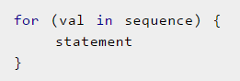
For Loops – Syntax
The syntax of a For Loop is the following:

Slide 112
For Loops – Syntax
The syntax of a For Loop is the following:
Where sequence is a vector and val takes on each value of the vector during the loop.

Slide 113
For Loops – Syntax
The syntax of a For Loop is the following:
Where sequence is a vector and val takes on each value of the vector during the loop.
In each iteration, statement is evaluated until the final val in the sequence, in which case, the loops exits.

Slide 114
For Loops – Example
Let’s take the example of interest rates (r) per country based on the maturity of an investment as presented in a 5 x 5 matrix:
Notes:
Pull up R and do the interest rate example

Slide 115
For Loops – Example
Let’s take the example of interest rates (r) per country based on the maturity of an investment as presented in a 5 x 5 matrix:
Notes:
Pull up R and do the interest rate example

Slide 116
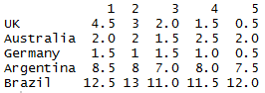
For Loops – Example
Let’s take the example of interest rates (r) per country based on the maturity of an investment as presented in a 5 x 5 matrix:
Notes:
Pull up R and do the interest rate example

Slide 117
For Loops – Example
Let’s take the example of interest rates (r) per country based on the maturity of an investment as presented in a 5 x 5 matrix:
Using these interest rates, we can calculate the value of an investment (P) using compound interest on a £100 investment for the 5 different maturities (t) in each country.
Notes:
Pull up R and do the interest rate example

Slide 118
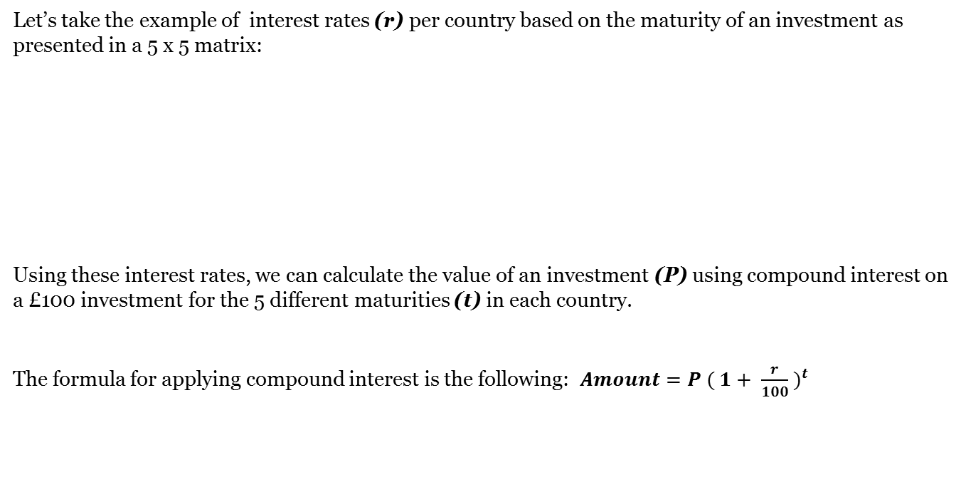
For Loops – Example
Let’s take the example of interest rates (r) per country based on the maturity of an investment as presented in a 5 x 5 matrix:
Using these interest rates, we can calculate the value of an investment (P) using compound interest on a £100 investment for the 5 different maturities (t) in each country.
The formula for applying compound interest is the following: $Amount={P ( 1+ \frac{r}{100} )}^{t}$
Notes:
Pull up R and do the interest rate example

Slide 119
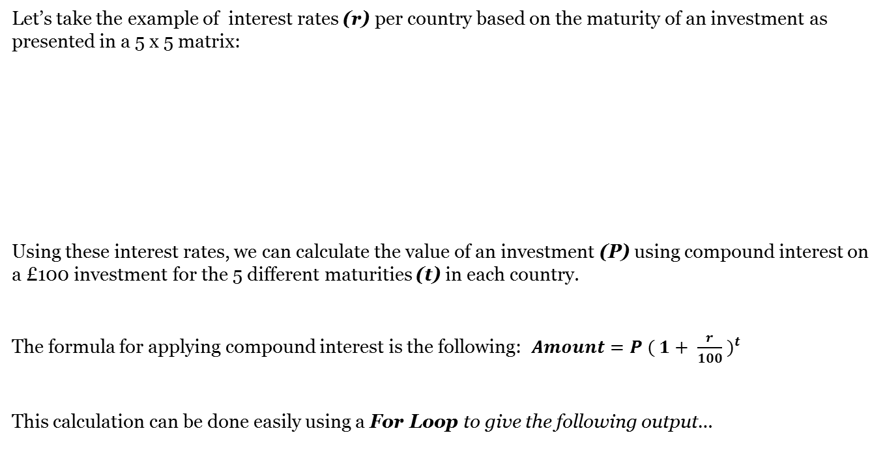
For Loops – Example
Let’s take the example of interest rates (r) per country based on the maturity of an investment as presented in a 5 x 5 matrix:
Using these interest rates, we can calculate the value of an investment (P) using compound interest on a £100 investment for the 5 different maturities (t) in each country.
The formula for applying compound interest is the following: $Amount={P ( 1+ \frac{r}{100} )}^{t}$
This calculation can be done easily using a For Loop to give the following output…
Notes:
Pull up R and do the interest rate example

Slide 120
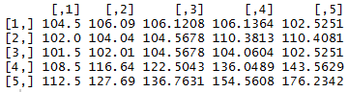
For Loops – Example
Let’s take the example of interest rates (r) per country based on the maturity of an investment as presented in a 5 x 5 matrix:
Using these interest rates, we can calculate the value of an investment (P) using compound interest on a £100 investment for the 5 different maturities (t) in each country.
The formula for applying compound interest is the following: $Amount={P ( 1+ \frac{r}{100} )}^{t}$
This calculation can be done easily using a For Loop to give the following output…
Notes:
Pull up R and do the interest rate example

Slide 121

While Loops
How does a While Loop work?

Slide 122

While Loops
How does a While Loop work?

Slide 123
While Loops
How does a While Loop work?
Before initiating the loop, the expression which determines the execution of the loop must be defined.

Slide 124
While Loops
How does a While Loop work?
Before initiating the loop, the expression which determines the execution of the loop must be defined.
The statement is executed using each TRUE value of the expression as an input on a case by case basis.

Slide 125
While Loops
How does a While Loop work?
Before initiating the loop, the expression which determines the execution of the loop must be defined.
The statement is executed using each TRUE value of the expression as an input on a case by case basis.
When the output of the expression returns FALSE, the loop operator terminates.

Slide 126
While Loops – Syntax
The syntax of a While Loop is the following:

Slide 127

While Loops – Syntax
The syntax of a While Loop is the following:

Slide 128
While Loops – Syntax
The syntax of a While Loop is the following:
test_expression is evaluated and the loop will be performed if a TRUE value is returned .

Slide 129
While Loops – Syntax
The syntax of a While Loop is the following:
test_expression is evaluated and the loop will be performed if a TRUE value is returned.
The statement inside the loop is executed and upon completion, the test_expression is evaluated again.

Slide 130
While Loops – Syntax
The syntax of a While Loop is the following:
test_expression is evaluated and the loop will be performed if a TRUE value is returned.
The statement inside the loop is executed and upon completion, the test_expression is evaluated again.
This process repeats until the evaluation of the test_expression returns FALSE, in which case, the loop exits.

Slide 131
While Loops – Example
Let’s take an example of an Individual who has invested £1,000 into a security with a fixed annual interest rate of 5%. At this rate of return how long would it take him to double his money?
Notes:
Pull up R and do the interest rate example

Slide 132

While Loops – Example
Let’s take an example of an Individual who has invested £1,000 into a security with a fixed annual interest rate of 5%. At this rate of return how long would it take him to double his money?
Notes:
Pull up R and do the interest rate example

Slide 133

Loops – Additional Information
In the previous examples, we have covered cases where you might want to iterate through columns or individual values to solve a mathematical problem. However, Loops also have the capability to loop through rows and columns.

Slide 134
Loops – Additional Information
In the previous examples, we have covered cases where you might want to iterate through columns or individual values to solve a mathematical problem. However, Loops also have the capability to loop through rows and columns.
Rows and Columns follow similar syntax, the only difference being the position of the variable in the statement.

Slide 135

Loops – Additional Information
In the previous examples, we have covered cases where you might want to iterate through columns or individual values to solve a mathematical problem. However, Loops also have the capability to loop through rows and columns.
Rows and Columns follow similar syntax, the only difference being the position of the variable in the statement.
Eg.

Slide 136

Loops – Additional Information
In the previous examples, we have covered cases where you might want to iterate through columns or individual values to solve a mathematical problem. However, Loops also have the capability to loop through rows and columns.
Rows and Columns follow similar syntax, the only difference being the position of the variable in the statement.
Eg.

Slide 137
Loops – Additional Information
In the previous examples, we have covered cases where you might want to iterate through columns or individual values to solve a mathematical problem. However, Loops also have the capability to loop through rows and columns.
Rows and Columns follow similar syntax, the only difference being the position of the variable in the statement.
Eg.
Note : it is useful to alternate between letters of the loop variable depending on whether you are looping through rows or columns in this case we have used i for columns and j for rows.

Slide 138
Loops – Additional Information
It is also useful to be able to loop through columns and rows for the same statement as it allows you to carry out complex analysis depending on the location of the value within a matrix.

Slide 139
Loops – Additional Information
It is also useful to be able to loop through columns and rows for the same statement as it allows you to carry out complex analysis depending on the location of the value within a matrix.
This can be performed by executing a loop inside another loop…

Slide 140

Loops – Additional Information
It is also useful to be able to loop through columns and rows for the same statement as it allows you to carry out complex analysis depending on the location of the value within a matrix.
This can be performed by executing a loop inside another loop…

Slide 141
Loops – Additional Information
It is also useful to be able to loop through columns and rows for the same statement as it allows you to carry out complex analysis depending on the location of the value within a matrix.
This can be performed by executing a loop inside another loop…
The above code multiplies the values in a matrix by the row number (j) and puts it to the power of the column number (i).

Slide 142
Loops – Additional Information
It is also useful to be able to loop through columns and rows for the same statement as it allows you to carry out complex analysis depending on the location of the value within a matrix.
This can be performed by executing a loop inside another loop…
The above code multiplies the values in a matrix by the row number (j) and puts it to the power of the column number (i).

Slide 143
Functions in R

Slide 144

Functions in R
An Introduction to Functions
Defining a function in R
Types/Defining Functions in R
Examples

Slide 145

Introduction to Functions in R
What are Functions in R?
They are small pieces of reusable code that can be treated like any other R object.

Slide 146



Introduction to Functions in R
What are Functions in R
They are small pieces of reusable code that can be treated like any other R object.
If you've worked through any other part of this course, you've probably used some functions already.

Slide 147

Introduction to Functions in R
What are Functions in R
Functions are one of the fundamental building blocks of the R language. They are small pieces of reusable code that can be treated like any other R object.
If you've worked through any other part of this course, you've probably used some functions already.
Functions are usually characterized by the name of the function followed by parentheses.
Function Name(Argument 1, Argument 2, …,Argument X)

Slide 148


Introduction to Functions in R Cont.
The structure of writing an R function:
Functions in R are "first class objects", which means that they can be treated much like any other R object.

Slide 149
Introduction to Functions in R Cont.
The structure of writing an R function:
Functions in R are "first class objects", which means that they can be treated much like any other R object.
Things to know…
Function can be passed as arguments to other function
Functions can be nested, so that you can define a function inside of another function. the return value of a function is the last express in the function body to be evaluated.

Slide 150
Introduction to Functions in R Cont.
The structure of writing an R function:
Functions in R are "first class objects", which means that they can be treated much like any other R object.
Things to know…
Function can be passed as arguments to other function
Functions can be nested, so that you can define a function inside of another function. the return value of a function is the last express in the function body to be evaluated.
Example:
The Sys.Date() function returns a string representing today's date.

Slide 151

Defining a Function
Functions usually take arguments which are variables that the function operates on.
Example:

Slide 152
Defining a Function
Functions usually take arguments which are variables that the function operates on.
Example:
The "variable name" we assign will become the name of our function. arg1 and arg2 represent the arguments of our function. We can manipulate the arguments we specify within the function.

Slide 153

Defining a Function
Functions usually take arguments which are variables that the function operates on.
Example:
The "variable name" we assign will become the name of our function. arg1 and arg2 represent the arguments of our function. We can manipulate the arguments we specify within the function.
After sourcing the function, you can use the function by typing:

Slide 154
Defining a Function
To see the source code for any function, just type the function name without any arguments or parentheses

Slide 155

Defining a Function
To see the source code for any function, just type the function name without any arguments or parentheses
In addition to not specifying a default value, you can also set an argument to NULL.

Slide 156

Defining a Function
To see the source code for any function, just type the function name without any arguments or parentheses
In addition to not specifying a default value, you can also set an argument to NULL.
Lazy Evaluation
Arguments to functions are evaluated lazily, so they are evaluated only as needed.
This function never actually uses the argument b, so calling f(2) will not produce and error because the 2 gets matched to a.

Slide 157
Function Arguments
‘Functions have named arguments which potentially have default values.
The formal arguments are the arguments included in the function definition
The formals function returns a list of all the formal arguments of a function
Not every function call in R makes use of all the formal arguments
Function arguments can be missing or might have default values
Example:
The mean() function takes a vector of numbers as input, and returns the average of all of the numbers in the input vector. Inputs to functions are often called arguments. Providing arguments to a function is also sometimes called passing arguments to that function. Arguments you want to pass to a function go inside the function's parentheses.
Try passing the argument c(2, 4, 5) to the mean() function.

Slide 158

Argument Matching
R function arguments can be matched positionally or by name. So the following calls to standard deviation (sd) are all equivalent.

Slide 159


Argument Matching
You can mix positional matching with matching by name. When an argument is matched by name, it is "taken out" of the argument list and the remaining unnamed arguments are matched in the order that they are listed in the function definition.
The following two calls are equivalent:

Slide 160
Argument Matching
Most of the time, names of arguments are useful on the command line when you have a long argument list and you want to use the defaults for everything except for an argument near the end of the list.
Named arguments also help if you cannot remember the name of the argument and its position on the argument list (plotting is a good example).
Function arguments can also be potentially matched, which is useful for interactive work. the order of operations when given an argument is:
Check for an exact match for a named argument
Check for a potential match (type part of the name)
Check for a positional match

Slide 161

Lazy Evaluation
Arguments to functions are evaluated lazily, so they are evaluated only as needed
"45" printed first before the error was triggered. This is because b did not have to be evaluated until after print(a). Once the function tried to evaluate print(b) it threw an error

Slide 162


The ‘ …’ Argument
The … argument indicate a variable number of arguments that are usually passed on to other functions.
… is often used when extending another function and you don't want to copy the entire argument list of the original function
Generic functions use … so that extra arguments can be passed to methods (more on this later).

Slide 163


The ‘ …’ Argument
The … is also necessary when the number of arguments passed to the function cannot be known in advance.
One catch with … is that any arguments that appear after … on the argument list must be named explicitly and cannot be partially matched.

Slide 164


Examples of Functions
Your first R function
Add two numbers together.
Take a vector and return a subset of numbers larger than 10.

Slide 165


More Examples of Functions
Take a vector and let the user define the number (but default to 10).
Take a matrix or a dataframe and calculate the mean of each column. Include an optional argument to keep or remove NA values in the data.

Slide 166
Conclusion

Slide 167


Capabilities of R
R is a completed system and offers a lot of benefits if you are interested in statistical or predictive modelling.
Many packages for applied statistics.
R allows you to import data from a variety of sources and then clean, recode and restructure it.
In the “real world” the biggest challenge is making data usable – there are always issues with the data you have to work with!
After importing data, R has many functions for summarizing, modeling, analysing and graphing data.
Statistical analysis tools include linear and nonlinear modeling, classical statistical test, time series analysis, classification, and clustering as well as other capabilities.
Further, R can readily be extended through functions and extensions; the R community is well known for active contributions of many packages.

Slide 168

Capabilities of R
R has powerful visualization tools. These range from simple charts to publication quality graphs, through dynamic visualization, to interactive graphics.
Visualization is key to successful data analytics – it aids analysis to better understand the results, and is an invaluable tool for explaining the results to others.
Providing information that can be used to make other capabilities like…
Machine Learning, Optimization and Mathematical Programming
Data Mining , Big Data Analytics
Signal Processing Simulation and Random Number Generation
Statistical Test and Modeling

Slide 169

Other capabilities of R
R can do regular expressions/text processing: Check out stringr, tm, and a large number of other natural language processing packages.
R can get data out of a database: Check out RMySQL, RMongoDB, rhdf5,ROracle, MonetDB.R (via Anthony D.).
R can process nasty data and images: Check out plyr, reshape2, Hmisc
R can handle different data formats: XML and RJSONIO handle two common types, but you can also read from Excel files with xlsx or handle pretty much every common data storage type (you'll have to search R + data type) to find the package.
R can interact with APIs: Check out RCurl and httr for general purpose software, You can create an api from R code using yhat.
R can build apps/interactive graphics: Some pretty cool things have already been built with shiny, rCharts interfaces with a ton of interactive graphics packages.
R can play with Hadoop: Check out the rhadoop wiki.

Slide 170

Resources available
Get Started With R
Here are three suggestions for beginners.
An Introduction to R – The free, “official” CRAN R Manual - https://cran.r-project.org/doc/manuals/R-intro.pdf
Try R – a short course that lets you jump right in - http://tryr.codeschool.com/
Computing for Data Analysis – 4 weeks worth of videos from a popular Coursera course
Quick-R – Practical examples http://www.statmethods.net/
An Introduction to R for Data Mining recorded webinar
Search online if you are interested in improving on your R skills.

